Slide 1




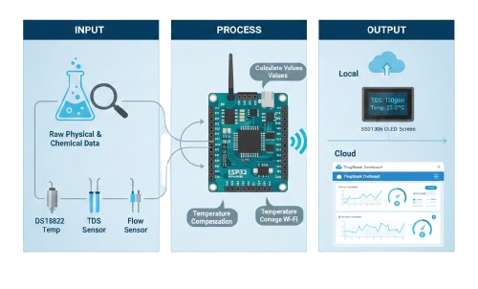

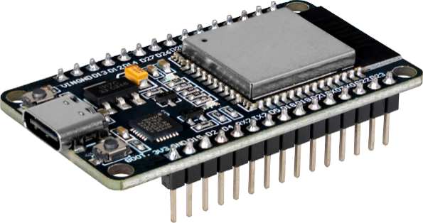
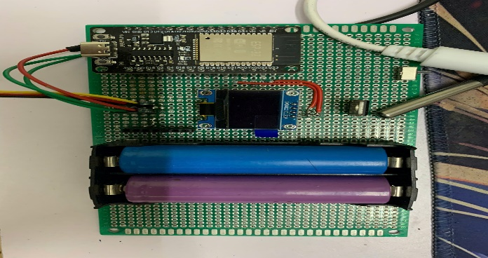
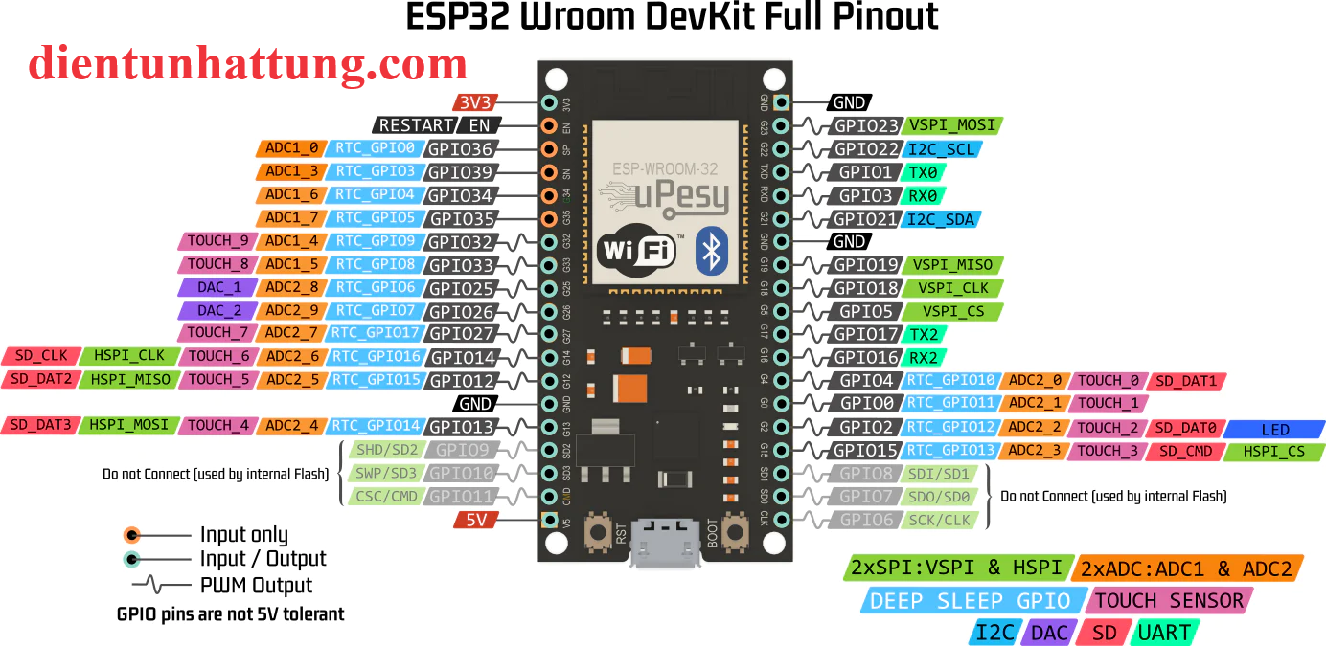
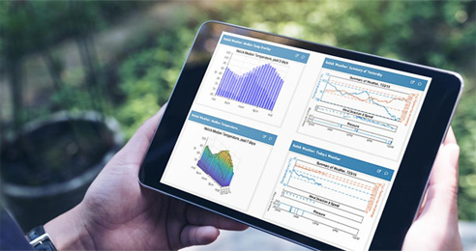
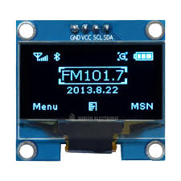
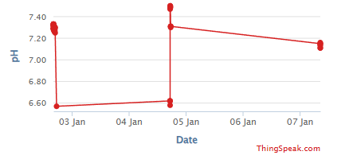
Successfully achieved high-precision monitoring with instant cloud synchronization and local display alerts.
Nam Anh
Water Quality Monitoring
I. Idea
III. System Architecture
Concept: An affordable, real-time IoT solution to monitor water health.
Core Technology: Uses ESP32 and Edge Computing to process sensor data and upload it to the ThingSpeak cloud platform via Wi-Fi.
Input: Sensors collect raw physical and chemical data from water.
Process: ESP32 calculates values and manages Wi-Fi connectivity.
Output: * Local: Real-time data visualization on an OLED screen.
Cloud: Data logging and graphing on the ThingSpeak dashboard.
II. Objectives
Automation: Replace manual testing with 24/7 continuous monitoring.
Accuracy: Provide temperature-compensated TDS (purity) readings.
Remote Access: Enable users to track water quality from anywhere via the internet.
IV. Innovation
V. Results
Low Cost: High performance at a fraction of the price of industrial meters.
Smart Calibration: Automatic temperature compensation for stable readings.
Versatility: Scalable for home use, aquaculture, and environmental protection.
Successfully achieved high-precision monitoring with instant cloud synchronization and local display alerts.
Thiết bị này sử dụng loại bức xạ điện từ nào?
Đặc điểm của nó là gì?

